Slide 1
Split Infinitive
Name
Institution Affiliations
Course Title
Date

Slide 2
Definition
An infinitive is a plain form of a verb which is basically available in dictionaries.
An infinitive is a verb which is normally go before by the participle “to”.
The word “to” is referred to as an infinitive maker.
Infinitives are used in day-to-day writing and conversations.
Infinitives can be used as adverbs, adjectives or nouns.
Notes:
This slide presents the definition of an infinitive and brief description of how an infinitive is used in grammar. The word “to” is usually used to make the infinitive by joining to the stem of the verb hence the name infinitive maker.

Slide 3
Examples of infinitives
There are various infinitives in the English language. They include:
To run
To eat
To be
To learn
To speak
Notes:
This slides represents few among many other infinitives which are available in the English grammar

Slide 4
What is a split infinitive?
A split infinitive is a writing construction which happens when two sections of infinitive are separated by a different word, (Close, 1987).
it is also known as cleft infinitive.
Examples are:
“To smartly dress”
“To quietly study”
Notes:
A split infinitive is constructed when , the word “to” and the bare infinitive are separated by another word, either an adverb or an adverbial phrase. In our examples, the words smartly and quietly have created our split infinitive since they have come in between the participle “to” and the infinitives “dress” and “study” respectively.

Slide 5
Changes in split infinitive rules
The rules of split infinitives changed mostly in the 20th century.
In the year 1904, major changes in the rules binding split infinitives occurred.
This year marks some social conventions and customs which were practiced in the United States, (Turiel, 1983).
Our discussion below focuses on the conventions and customs surrounding dressing and fashion, rules of etiquette and writing conventions.

Slide 6
Definition of social conventions and customs
Social conventions refers to the basic rules and norms which govern a huge number of behaviors.
Customs are the cultural ideas which describe the pattern of behavior which is characteristic of the lifestyle in a certain social system.
Notes:
Conventions usually guide the behaviour in which everybody should engage in day in day out, without thinking about the rules. They include driving on the right side and greeting others. Customs are usually culturally based and are transferred from one generation to another. The members of the specific culture are expected to follow their customs.

Slide 7
Dress and fashion conventions and customs.
During the first decade of the 1990s, the society went under a great transformation across all aspects.
Women matched dresses with hats and also added an umbrella.
Fashion was majorly expressed in high collars, long sleeves and even gloves.
edwardian blouse and a maxi-skirt were also common, (Roche, 1996).
Men wore shirts, ties and darker of neutral color.
Notes:
Neutral color in this period was associated with serious work.

Slide 8
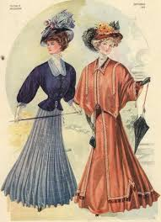
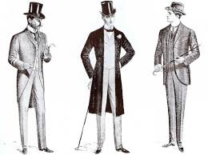
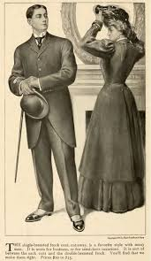
Dress and fashion conventions and customs.
See the dress and fashion here

Slide 9
Rules of etiquette conventions
Rules of etiquette refers to the good manners.
They are usually out of common sense so that work flows smoothly at all times.
These rules are similar all over.
They include:
Be on time
Personal space, (Shea, 1994).
Decent conversations
Handling cell phones
Notes:
Always try to be on time. Nobody enjoys waiting for others who usually come late. When you are late out your control, sent an earlier apology to be late. If you see somebody squirming, give them their personal time. Learn how to communicate well when giving information or responding. Do not moonlike the discussion. It is wrong to be talking on phone , chatting or texting at an official place or talking about private things in public.

Slide 10
Writing conventions
Writing conventions refer to the elements which make it easy to understand writing and make it clear.
They include spellings, punctuation, capitalizations and grammar.
Punctuation was a fairly made creation to lead speakers convey texts written by other people.
Grammar was meant to create the smooth flow of events described in the sentences.

Slide 11
Conclusion
Social conventions and customs cover a very wide range of transformations century to century, decade in decade out.
The year 1904 marks a year when rules split infinitives were published.
this year also marks great social conventions and customs in dressing and fashion, etiquette rules and writing conventions as discussed above.
Notes:
Social conventions and customs cover a very wide range of transformations century to century, decade in decade out.
The year 1904 marks a year when rules split infinitives were published.
this year also marks great social conventions and customs in dressing and fashion, etiquette rules and writing conventions as discussed above

Slide 12
Reference
Roche, D. (1996). The culture of clothing: dress and fashion in the Ancien Régime. Cambridge University Press.
Shea, V. (1994). Core Rules of Netiquette. Educom Review, 29(5), 58-62.
Close, R. A. (1987). Notes on the split infinitive. Journal of English Linguistics, 20(2), 217-229.
Turiel, E. (1983). The development of social knowledge: Morality and convention. Cambridge University Press.

